Slide 1



Machine learning as an auxiliary tool for computational chemistry
XXII Brazilian Symposium on Theoretical Chemistry
Dr. Henrique de Castro Silva Junior

Slide 2
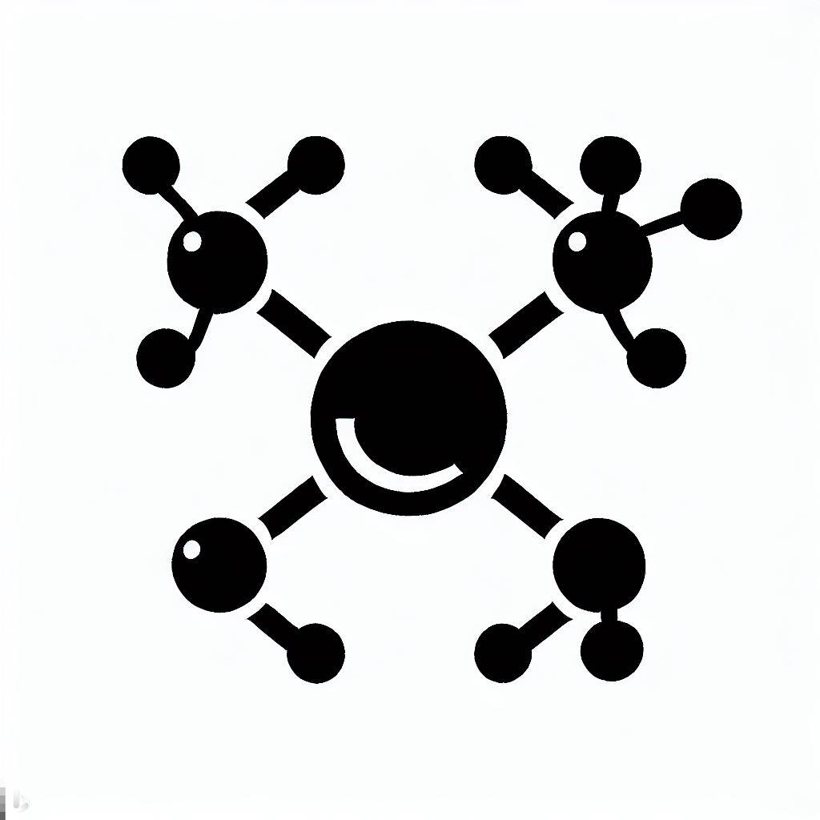
Day 2 Dealing with molecules

Slide 3
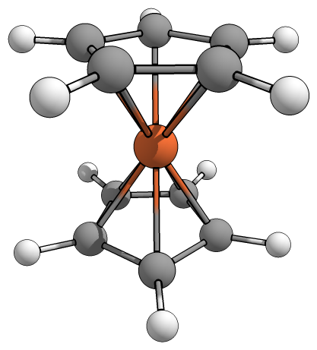
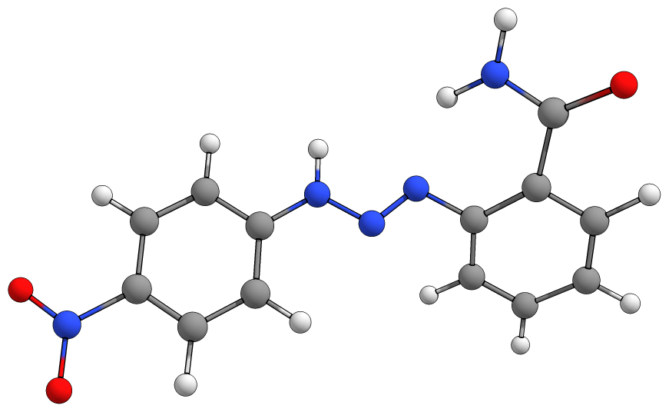
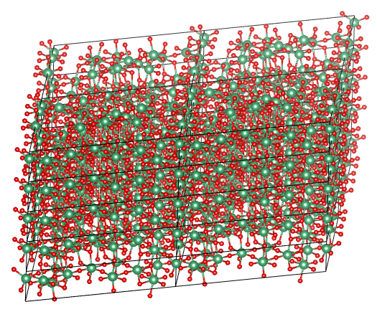
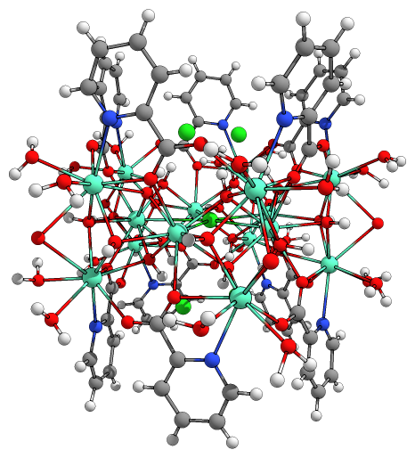
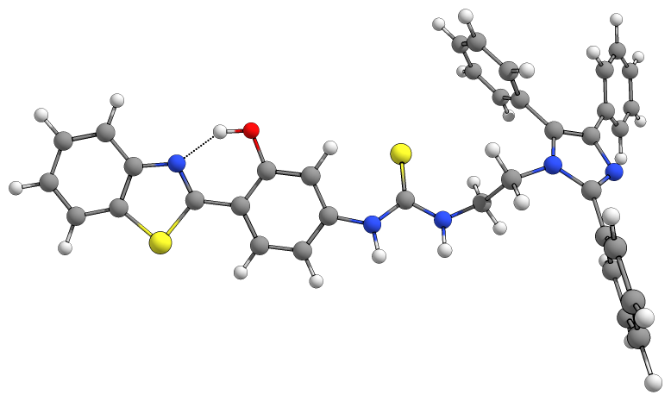
Representing chemical data in a concise and unambiguous way, understandable by both humans and machines, is not an easy task

Slide 4
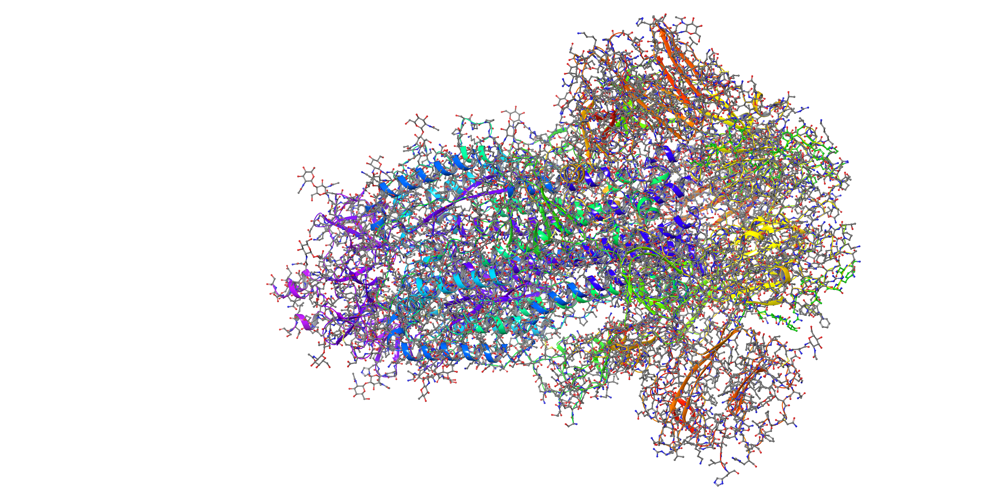
Representing chemical data in a concise and unambiguous way, understandable by both humans and machines, is not an easy task
6VXX - Structure of the SARS-CoV-2 spike glycoprotein

Slide 5
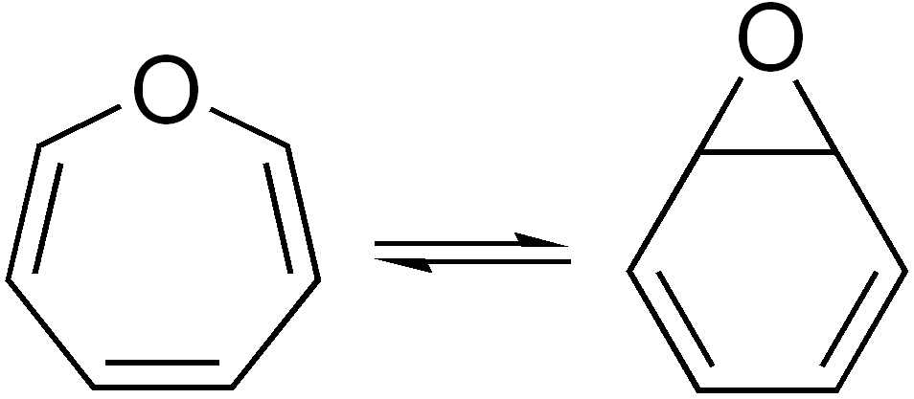
(Un)avoidable problems
noncanonical
multiple different representations for the same molecule
nonunique/clashing
multiple different molecules that are encoded into the same representation
Oxepin – C₆H₆O

Slide 6
(Un)avoidable problems
noncanonical
multiple different representations for the same molecule
nonunique/clashing
multiple different molecules that are encoded into the same representation
assuming the wrong number of implicit H atoms
failing to capture tautomerism

Slide 7
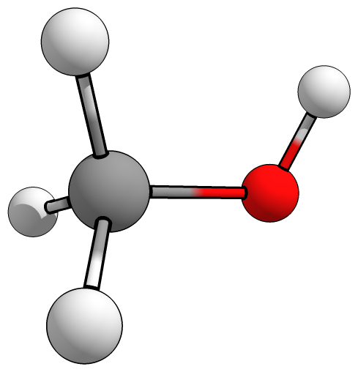
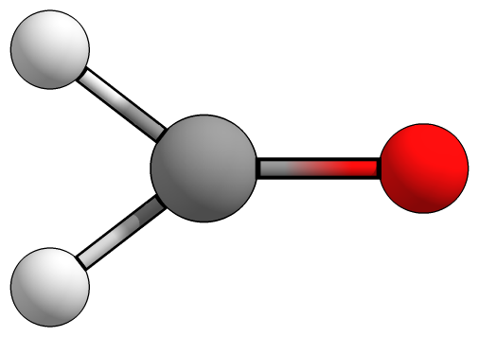
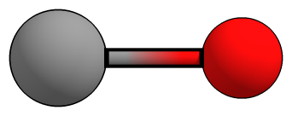
(Un)avoidable problems
assuming the wrong number of implicit H atoms
failing to capture tautomerism
CO

Slide 8
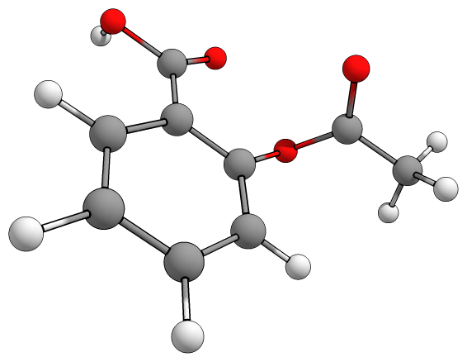
A quick test: Round-trip conversion
Aspirin
O=C(C)OC(=CC=C1)C(=C1)C(=O)O

Slide 9
Generic names | Zidovudine (AZT)
Mol. formula | C₁₀H₁₃N₅O₄
IUPAC name | 1-[(2R,4S,5S)-4-Azido-5-(hydroxymethyl)tetrahydro-2-furyl]-5-methyl-2,4(1H,3H)-pyrimidinedione
CAS RN | 30516-87-1
Canonical SMILES | OC[C@@H](O[C@H]1N(:C:C(C):C2=O):C(=O):N:2)[C@H](C1)N=[N+]=[N-]
InChI | InChI=1S/C10H13N5O4/c1-5-3-15(10(18)12-9(5)17)8-2-6(13-14-11)7(4-16)19-8/h3,6-8,16H,2,4H2,1H3,(H,12,17,18)/t6-,7+,8+/m0/s1 Key:HBOMLICNUCNMMY-XLPZGREQSA-N

Slide 10
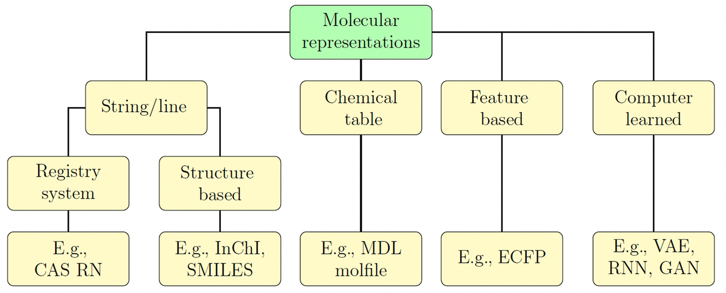

Slide 11

Feeding molecules to an AI

Slide 12
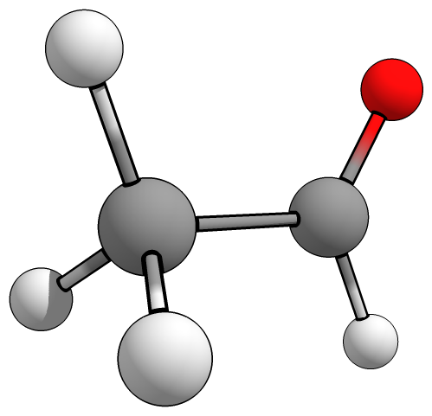
XYZ Matrix
O 0.396589377919 0.000000000004 -3.465122980611
C 0.396589377919 0.458887359362 -2.344760836930
C 0.396589377920 -0.363967579437 -1.081972135229
H -0.483097622080 -0.113741894107 -0.476303363544
H 0.396589377920 -1.428968631061 -1.319897509388
H 1.276276377920 -0.113741894107 -0.476303363545
H 0.396589377920 1.561532639346 -2.183662185962

Slide 13
XYZ Matrix
O 0.396589377919 0.000000000004 -3.465122980611
C 0.396589377919 0.458887359362 -2.344760836930
C 0.396589377920 -0.363967579437 -1.081972135229
H -0.483097622080 -0.113741894107 -0.476303363544
H 0.396589377920 -1.428968631061 -1.319897509388
H 1.276276377920 -0.113741894107 -0.476303363545
H 0.396589377920 1.561532639346 -2.183662185962
One-hot encoding

Slide 14
XYZ Matrix
O 0.396589377919 0.000000000004 -3.465122980611
C 0.396589377919 0.458887359362 -2.344760836930
C 0.396589377920 -0.363967579437 -1.081972135229
H -0.483097622080 -0.113741894107 -0.476303363544
H 0.396589377920 -1.428968631061 -1.319897509388
H 1.276276377920 -0.113741894107 -0.476303363545
H 0.396589377920 1.561532639346 -2.183662185962
One-hot encoding
O, C, H
[0,0,0]
O = [1,0,0]
C = [0,1,0]
H = [0,0,1]

Slide 15
XYZ Matrix
[1,0,0] 0.396589377919 0.000000000004 -3.465122980611
[0,1,0] 0.396589377919 0.458887359362 -2.344760836930
[0,1,0] 0.396589377920 -0.363967579437 -1.081972135229
[0,0,1] -0.483097622080 -0.113741894107 -0.476303363544
[0,0,1] 0.396589377920 -1.428968631061 -1.319897509388
[0,0,1] 1.276276377920 -0.113741894107 -0.476303363545
[0,0,1] 0.396589377920 1.561532639346 -2.183662185962
One-hot encoding
O, C, H
[0,0,0]
O = [1,0,0]
C = [0,1,0]
H = [0,0,1]

Slide 16

In Python…

Slide 17
XYZ Matrix
8 0.396589377919 0.000000000004 -3.465122980611
6 0.396589377919 0.458887359362 -2.344760836930
6 0.396589377920 -0.363967579437 -1.081972135229
1 -0.483097622080 -0.113741894107 -0.476303363544
1 0.396589377920 -1.428968631061 -1.319897509388
1 1.276276377920 -0.113741894107 -0.476303363545
1 0.396589377920 1.561532639346 -2.183662185962

Slide 18
In Python…

Slide 19



XYZ Matrix
8 0.396589377919 0.000000000004 -3.465122980611
6 0.396589377919 0.458887359362 -2.344760836930
6 0.396589377920 -0.363967579437 -1.081972135229
1 -0.483097622080 -0.113741894107 -0.476303363544
1 0.396589377920 -1.428968631061 -1.319897509388
1 1.276276377920 -0.113741894107 -0.476303363545
1 0.396589377920 1.561532639346 -2.183662185962
Easy to read
Invariance
Dimensionality
Lack of information
Contextual Information
Standardization

Slide 20
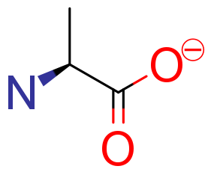
MDL Mol format
Mrv2310 08232311192D
0 0 0 0 0 999 V3000
M V30 BEGIN CTAB
M V30 COUNTS 6 5 0 0 1
M V30 BEGIN ATOM
M V30 1 N -3.1395 -0.3241 0 0
M V30 2 C -1.8058 0.4459 0 0 CFG=2
M V30 3 C -0.4721 -0.3241 0 0
M V30 4 O 0.8616 0.4459 0 0 CHG=-1
M V30 5 O -0.4721 -1.8641 0 0
M V30 6 C -1.8058 1.9859 0 0
M V30 END ATOM
M V30 BEGIN BOND
M V30 1 1 2 1 CFG=1
M V30 2 1 2 3
M V30 3 1 3 4
M V30 4 2 3 5
M V30 5 1 2 6
M V30 END BOND
M V30 END CTAB
M END
L‐alaninate

Slide 21
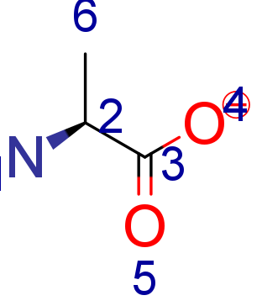
MDL Mol format
Mrv2310 08232311192D
0 0 0 0 0 999 V3000
M V30 BEGIN CTAB
M V30 COUNTS 6 5 0 0 1
M V30 BEGIN ATOM
M V30 1 N -3.1395 -0.3241 0 0
M V30 2 C -1.8058 0.4459 0 0 CFG=2
M V30 3 C -0.4721 -0.3241 0 0
M V30 4 O 0.8616 0.4459 0 0 CHG=-1
M V30 5 O -0.4721 -1.8641 0 0
M V30 6 C -1.8058 1.9859 0 0
M V30 END ATOM
M V30 BEGIN BOND
M V30 1 1 2 1 CFG=1
M V30 2 1 2 3
M V30 3 1 3 4
M V30 4 2 3 5
M V30 5 1 2 6
M V30 END BOND
M V30 END CTAB
M END

Slide 22
Feature/Property | Mol V2000 | Mol V3000 | Mol2 | PDB
Standardization | ✓ MDL Molfile Standard | ✓ MDL Molfile Standard | ✗ Sybyl Standard | ✓ PDB Standard
Data Fields | Basic (atom types, bond types) | Extended (atom lists, bond lists, textual data) | Extended (atom types, bond types, substructure, textual data) | Extended (atom types, 3D coordinates, residues, chains)
Small Molecules | ✓ Suitable | ✓ Suitable | ✓ Suitable | ✓ Suitable
Large Molecules | ✗ Not Suitable (Limited to 999 atoms and bonds) | ✓ Suitable | ✓ Suitable | ✓ Suitable
2D Coordinates | ✓ Supported | ✓ Supported | ✓ Supported | ✗ Not Supported
3D Coordinates | ✓ Supported | ✓ Supported | ✓ Supported | ✓ Supported
Multiple Coordinate Sets | ✗ Not Supported | ✗ Not Supported | ✓ Supported | ✓ Supported (through MODEL/ENDMDL records)
Additional Atom/Bond Properties | ✗ Not Supported | ✓ Supported | ✓ Supported | ✓ Supported (occupancy, B-factor, etc.)
Complex Structures (e.g., macromolecules) | ✗ Not Suitable | ✓ Suitable | ✓ Suitable | ✓ Suitable
Force Field Specific Information | ✗ Not Supported | ✗ Not Supported | ✓ Supported (Sybyl Specific) | ✗ Not Supported
Human-Readable | ✓ Readable | ✗ Less Readable | ✓ Readable | ✓ Readable
Software Support | ✓ Widely Supported | ✓ Moderately Supported | ✓ Moderately Supported | ✓ Widely Supported
Ease of Use | ✓ Easy | ✗ Moderate | ✓ Moderate | ✓ Moderate

Slide 23

MDL Mol format
Mrv2310 08232311192D
0 0 0 0 0 999 V3000
M V30 BEGIN CTAB
M V30 COUNTS 6 5 0 0 1
M V30 BEGIN ATOM
M V30 1 N -3.1395 -0.3241 0 0
M V30 2 C -1.8058 0.4459 0 0 CFG=2
M V30 3 C -0.4721 -0.3241 0 0
M V30 4 O 0.8616 0.4459 0 0 CHG=-1
M V30 5 O -0.4721 -1.8641 0 0
M V30 6 C -1.8058 1.9859 0 0
M V30 END ATOM
M V30 BEGIN BOND
M V30 1 1 2 1 CFG=1
M V30 2 1 2 3
M V30 3 1 3 4
M V30 4 2 3 5
M V30 5 1 2 6
M V30 END BOND
M V30 END CTAB
M END
Not as easy to read, but packs relevant chemical information
Easy to feed to preprocessing libraries
L‐alaninate

Slide 24
In Python…

Slide 25

Molecular fingerprints

Slide 26
Molecular fingerprints are compact representations of molecular structures, typically in the form of binary strings (bit vectors) or count vectors.
Each bit or count in the fingerprint represents the presence, absence, or frequency of a particular substructure, property, or pattern in the molecule.

Slide 27
MACCS (Molecular ACCess System)
Binary Representation: MACCS keys are typically represented as a binary bit-vector of length 166. Each bit in the vector corresponds to one of the predefined substructures. If a particular substructure is present in the molecule, the corresponding bit is set to 1; otherwise, it is set to 0.
Substructure-Based: Unlike some fingerprints that are based on hashing algorithms (like ECFP), MACCS keys are directly derived from a predefined list of substructures. This means that each bit in the MACCS key has a specific, interpretable meaning.
Empirical Design: The MACCS key set was designed empirically, based on the experience of chemists and the kinds of substructures they found to be important for differentiating molecules and predicting their properties.
D. J. Polton, Online Rev., 1982, Volume 6, 235–242.

Slide 28
In Python…

Slide 29
Morgan
a circular fingerprint used in cheminformatics to represent the structure of a molecule. It captures the local environment of each atom in the molecule, encoding it as a hash. These local environments are generated through an iterative "neighborhood expansion" process.
H. L. Morgan, J. Chem. Doc., 1965, 5, 107–113.
A. P. Bartók, R. Kondor and G. Csányi, Phys. Rev. B, 2013, 87, 184115.

Slide 30
Morgan
a circular fingerprint used in cheminformatics to represent the structure of a molecule. It captures the local environment of each atom in the molecule, encoding it as a hash. These local environments are generated through an iterative "neighborhood expansion" process.
Radius
A. P. Bartók, R. Kondor and G. Csányi, Phys. Rev. B, 2013, 87, 184115.

Slide 31
In Python…

Slide 32
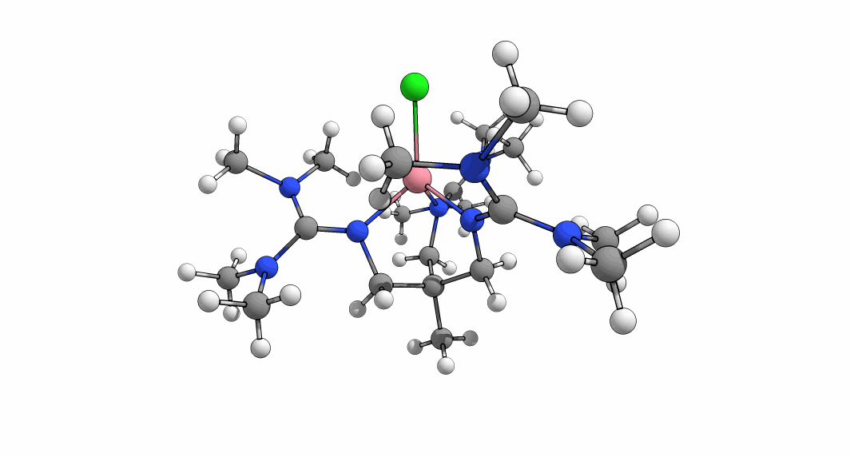
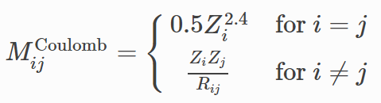
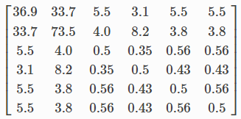
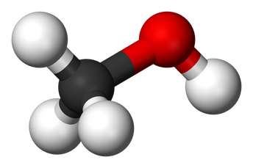
When geometry matters…
Several methods proposed
Advantages and drawbacks… as always
Coulomb Matrix

Slide 33
In Python…

Slide 34
When geometry matters…
Several methods proposed
Advantages and drawbacks… as always
Coulomb Matrix

Slide 35
Coulomb Matrix
Disadvantages:
Permutation Variance: The Coulomb matrix is not invariant under permutations of identical atoms. This means that reordering the atoms in the molecular structure changes the Coulomb matrix, making it sensitive to the input atomic ordering.
Size Variability: For different molecules with varying numbers of atoms, the size of the Coulomb matrix changes, making it difficult to directly compare matrices of different dimensions.
Sparse Information: The Coulomb matrix may not capture all the nuances of the electronic structure of a molecule. For instance, it does not incorporate bond angle or torsional information.

Slide 36
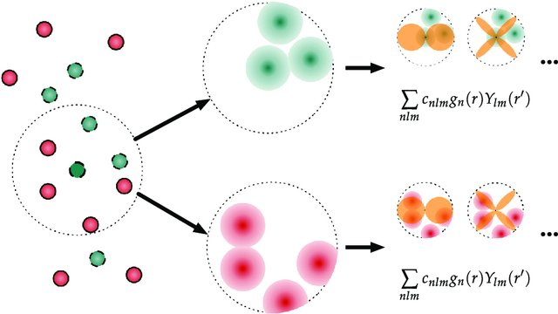
Smooth Overlap of Atomic Positions (SOAP)
A descriptor that encodes regions of atomic geometries by using a local expansion of a gaussian smeared atomic density with orthonormal functions based on spherical harmonics and radial basis functions.
Invariance: Invariant to translations, rotations, and permutations of atoms.
Smoothness: Smooth integration over local environments makes it robust to slight perturbations.
Differentiability: Can be made differentiable with respect to atomic positions for gradient-based optimization.
Hierarchical Information: Captures multi-body interactions in the atomic environment.
Compact Representation: Provides a high-dimensional but compact representation of the local atomic environment.
Versatility: Applicable to both molecules and materials across various systems.

Slide 37
Smooth Overlap of Atomic Positions (SOAP)
A descriptor that encodes regions of atomic geometries by using a local expansion of a gaussian smeared atomic density with orthonormal functions based on spherical harmonics and radial basis functions.
Invariance: Invariant to translations, rotations, and permutations of atoms.
Smoothness: Smooth integration over local environments makes it robust to slight perturbations.
Differentiability: Can be made differentiable with respect to atomic positions for gradient-based optimization.
Hierarchical Information: Captures multi-body interactions in the atomic environment.
Compact Representation: Provides a high-dimensional but compact representation of the local atomic environment.
Versatility: Applicable to both molecules and materials across various systems.
M. F. Langer, A. Goeßmann and M. Rupp, npj Comput. Mater., 2022, 8, 41.
S. De, A. P. Bartók, G. Csányi and M. Ceriotti, Phys. Chem. Chem. Phys., 2016, 18, 13754–13769.
A. P. Bartók, R. Kondor and G. Csányi, Phys. Rev. B, 2013, 87, 184115.

Slide 38
In Python…

Slide 39
Smooth Overlap of Atomic Positions (SOAP)
A descriptor that encodes regions of atomic geometries by using a local expansion of a gaussian smeared atomic density with orthonormal functions based on spherical harmonics and radial basis functions.
Invariance: Invariant to translations, rotations, and permutations of atoms.
Smoothness: Smooth integration over local environments makes it robust to slight perturbations.
Differentiability: Can be made differentiable with respect to atomic positions for gradient-based optimization.
Hierarchical Information: Captures multi-body interactions in the atomic environment.
Compact Representation: Provides a high-dimensional but compact representation of the local atomic environment.
Versatility: Applicable to both molecules and materials across various systems.
High Complexity: Requires significant computational resources, especially for larger systems.
Lack of Intuition: Descriptors are mathematically complex and not directly interpretable in terms of physical properties.
Tuning Required: Optimal performance often requires fine-tuning of various hyperparameters.
Sensitivity to Hyperparameters: Choice of hyperparameters can affect the invariances (e.g., rotational, translational) that the descriptors are supposed to capture.
High-dimensional Data: The descriptors can be high-dimensional and memory-intensive, which can be a limitation for large-scale applications.

Slide 40
Tomorrow: Working with Datasets and Forests
SBQT Day 3

